Slide 1

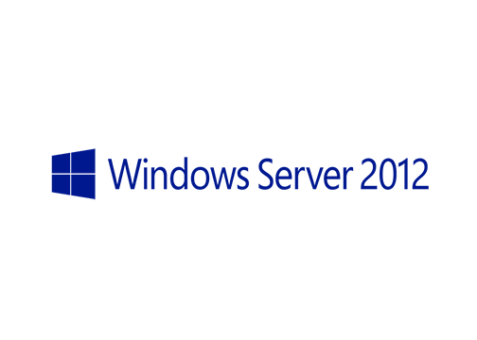
MegaSeries
Introduction to NIC Teaming

Slide 2
Info
New feature added in Windows Server 2012
Fully supported by Microsoft
Combine 2 or more NICs so that software above this layer sees them as 1 NIC
Vendor and speed agnostic
Provides bandwidth aggregation and failure protection
Integrated in Server Manager and has Powershell CmdLets

Slide 3
Terms
Team members: Hardware network adapters added to teams
Team interfaces (Team NICs): Virtual network adapters exposed by the team which the OS and software will consider as the usable NICs

Slide 4
Types
Load distribution modes
Address hash
Hyper-V port
Connection modes
Switch independent: Team members can be connected to different switches; No switch configuration required
Switch dependent: Team members have to be connected to the same switch; Switch configuration required

Slide 5
Team interfaces
Can be in the default mode: permits all traffic except traffic with VLAN ID assigned to another Team interface
Can be in VLAN mode: permits only traffic tagged with the VLAN ID the interface is configured with
Only the first team interface of a team can be in Default mode

Slide 6
Team members
Active
Standby
Teams can have only active members or a combination of active and standby

Slide 7
Limits
Maximum 32 NICs per team
Maximum 32 team interfaces per team
Maximum 32 teams per server
Depending on configurations you choose you will not be able to meet all 3 limits at the same time

Slide 8
Hyper-V support
Teaming is supported in Hyper-V virtual machines
Configuration of the VM network adapter from the Hyper-V server required
In a VM only 2 NICs can be placed in a team
The 2 NICs have to be connected to 2 different external switches on the host

Slide 9
https://www.youtube.com/channel/UCcZ-jLbPwNr8E_v9-65n8Iw https://github.com/itknowledge4

